Slide 1
A Layered Approach for Multi-Agent Path Finding
Honghao Chen
119010014
2022-12-30
Notes:
自我介绍等

Slide 2
Content
1. Background & Problem Formulation
2. Methodology
2.1 Architecture Overview: New Layered Approach
2.2 Offline Preprocessing Phase
2.3 Online Scheduling Phase
3. Simulation Results
Notes:
分为三部分

Slide 3
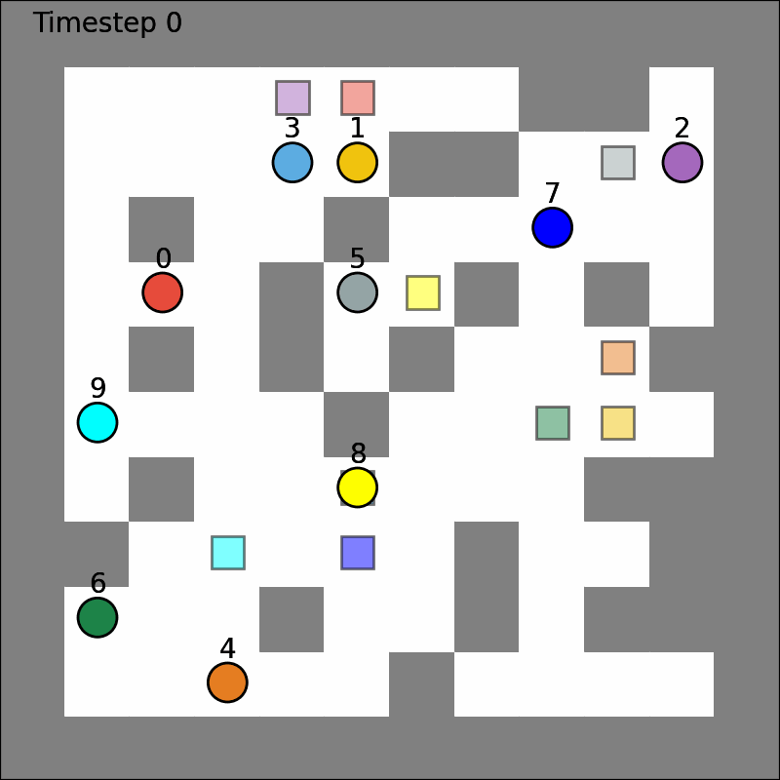
1. Background & Problem Formulation
What is Multi-Agent Path Finding (MAPF)?
Multi-Agent Path Finding (MAPF) is a problem to schedule collision-free paths for a group of agents to their target locations.
Typically modeled as grid maps.
Ref: https://jiaoyangli.me/research/mapf/

Slide 4
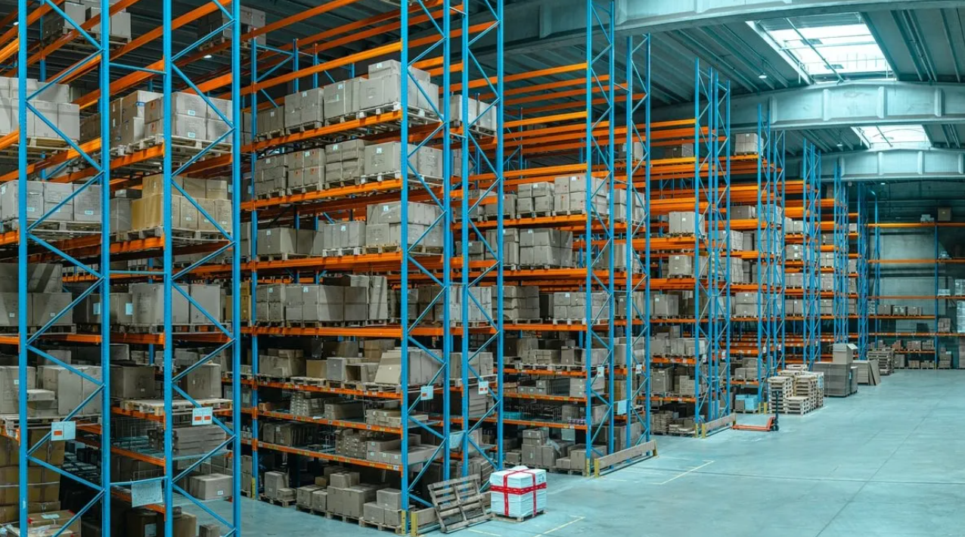

1. Background & Problem Formulation
Applications of MAPF
Warehouse
Restaurant
Ref: https://www.globaltrademag.com/ how-to-optimize-waste-management-in-your-warehouse/

Slide 5
1. Background & Problem Formulation
Gaps of current MAPF algorithms:
Many of them cannot be easily applied to real-world scenarios
Three features we want to support:
1. Support lifelong MAPF
2. Optimize for maps with high connectivity
3. Support scalability

Slide 6
1. Background & Problem Formulation
Three features we want to support:
1. Support lifelong MAPF
Lifelong MAPF is an extension of (standard) MAPF.
Agents will constantly be assigned new goal locations once they have arrived at their current goal locations.
2. Optimize for maps with high connectivity
3. Support scalability

Slide 7
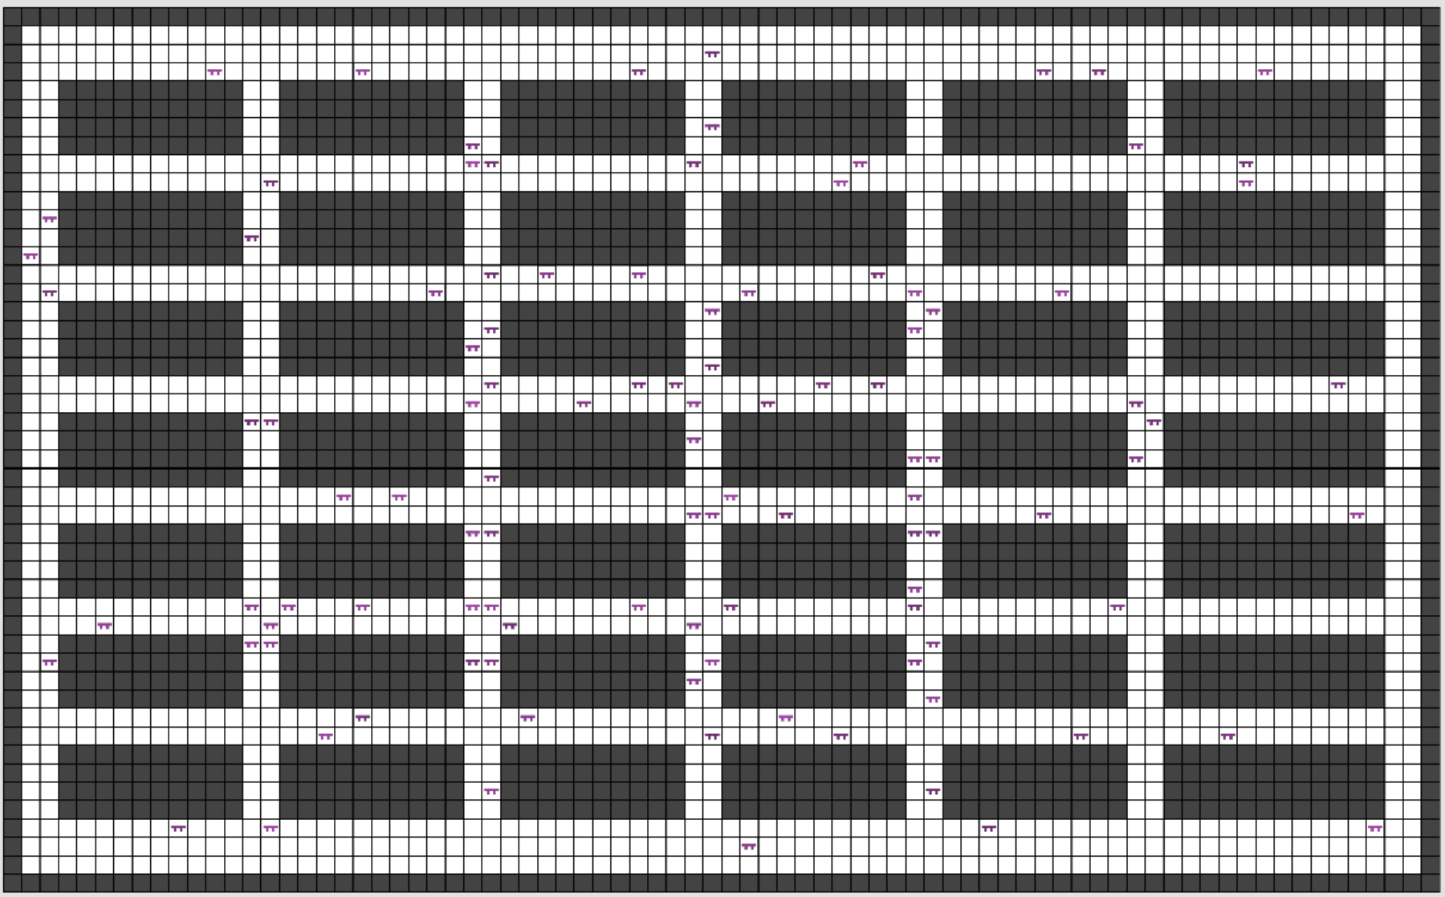
1. Background & Problem Formulation
Three features we want to support:
Support lifelong MAPF
2. Optimize for maps with high connectivity
Given a source and target location pair in the maps, multiple alternative paths can usually be found.
3. Support scalability

Slide 8
2. Methodology
2.1 Architecture Overview: New Layered Approach
2.2 Offline Preprocessing Phase
2.3 Online Scheduling Phase

Slide 9
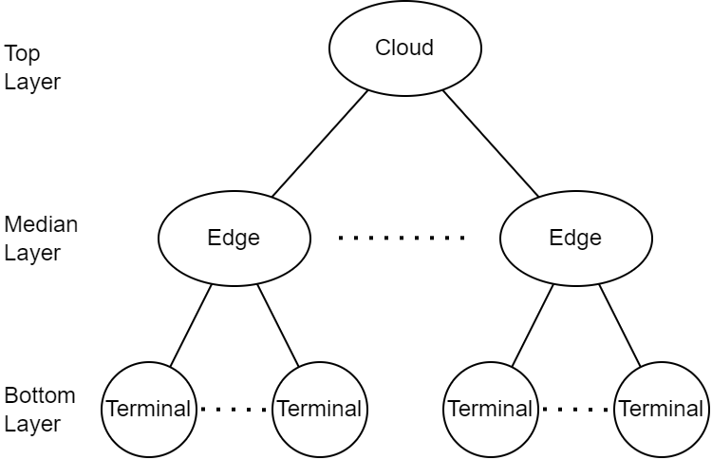
2.1 Architecture Overview: New Layered Approach
Hybrid Cloud-edge-terminal Architecture

Slide 10
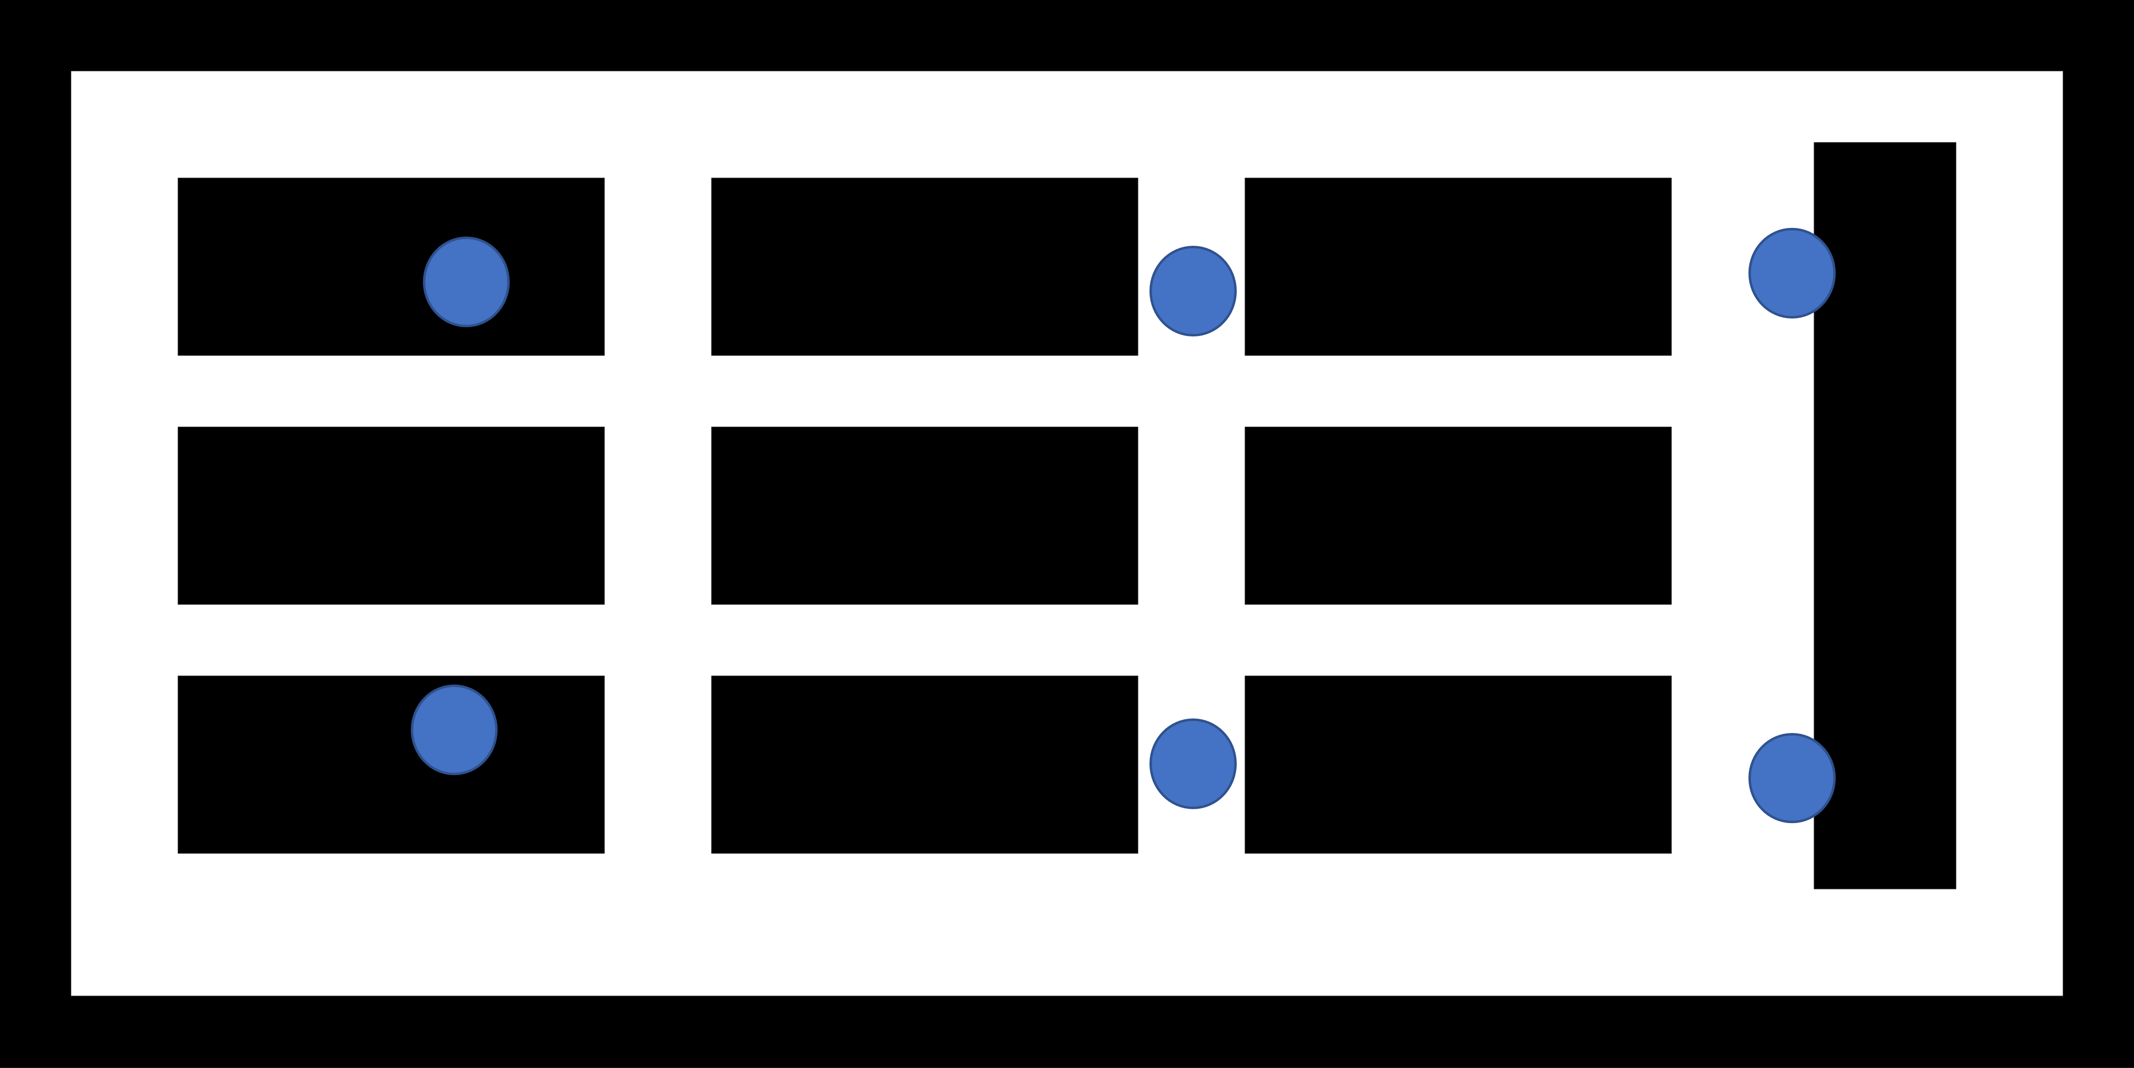
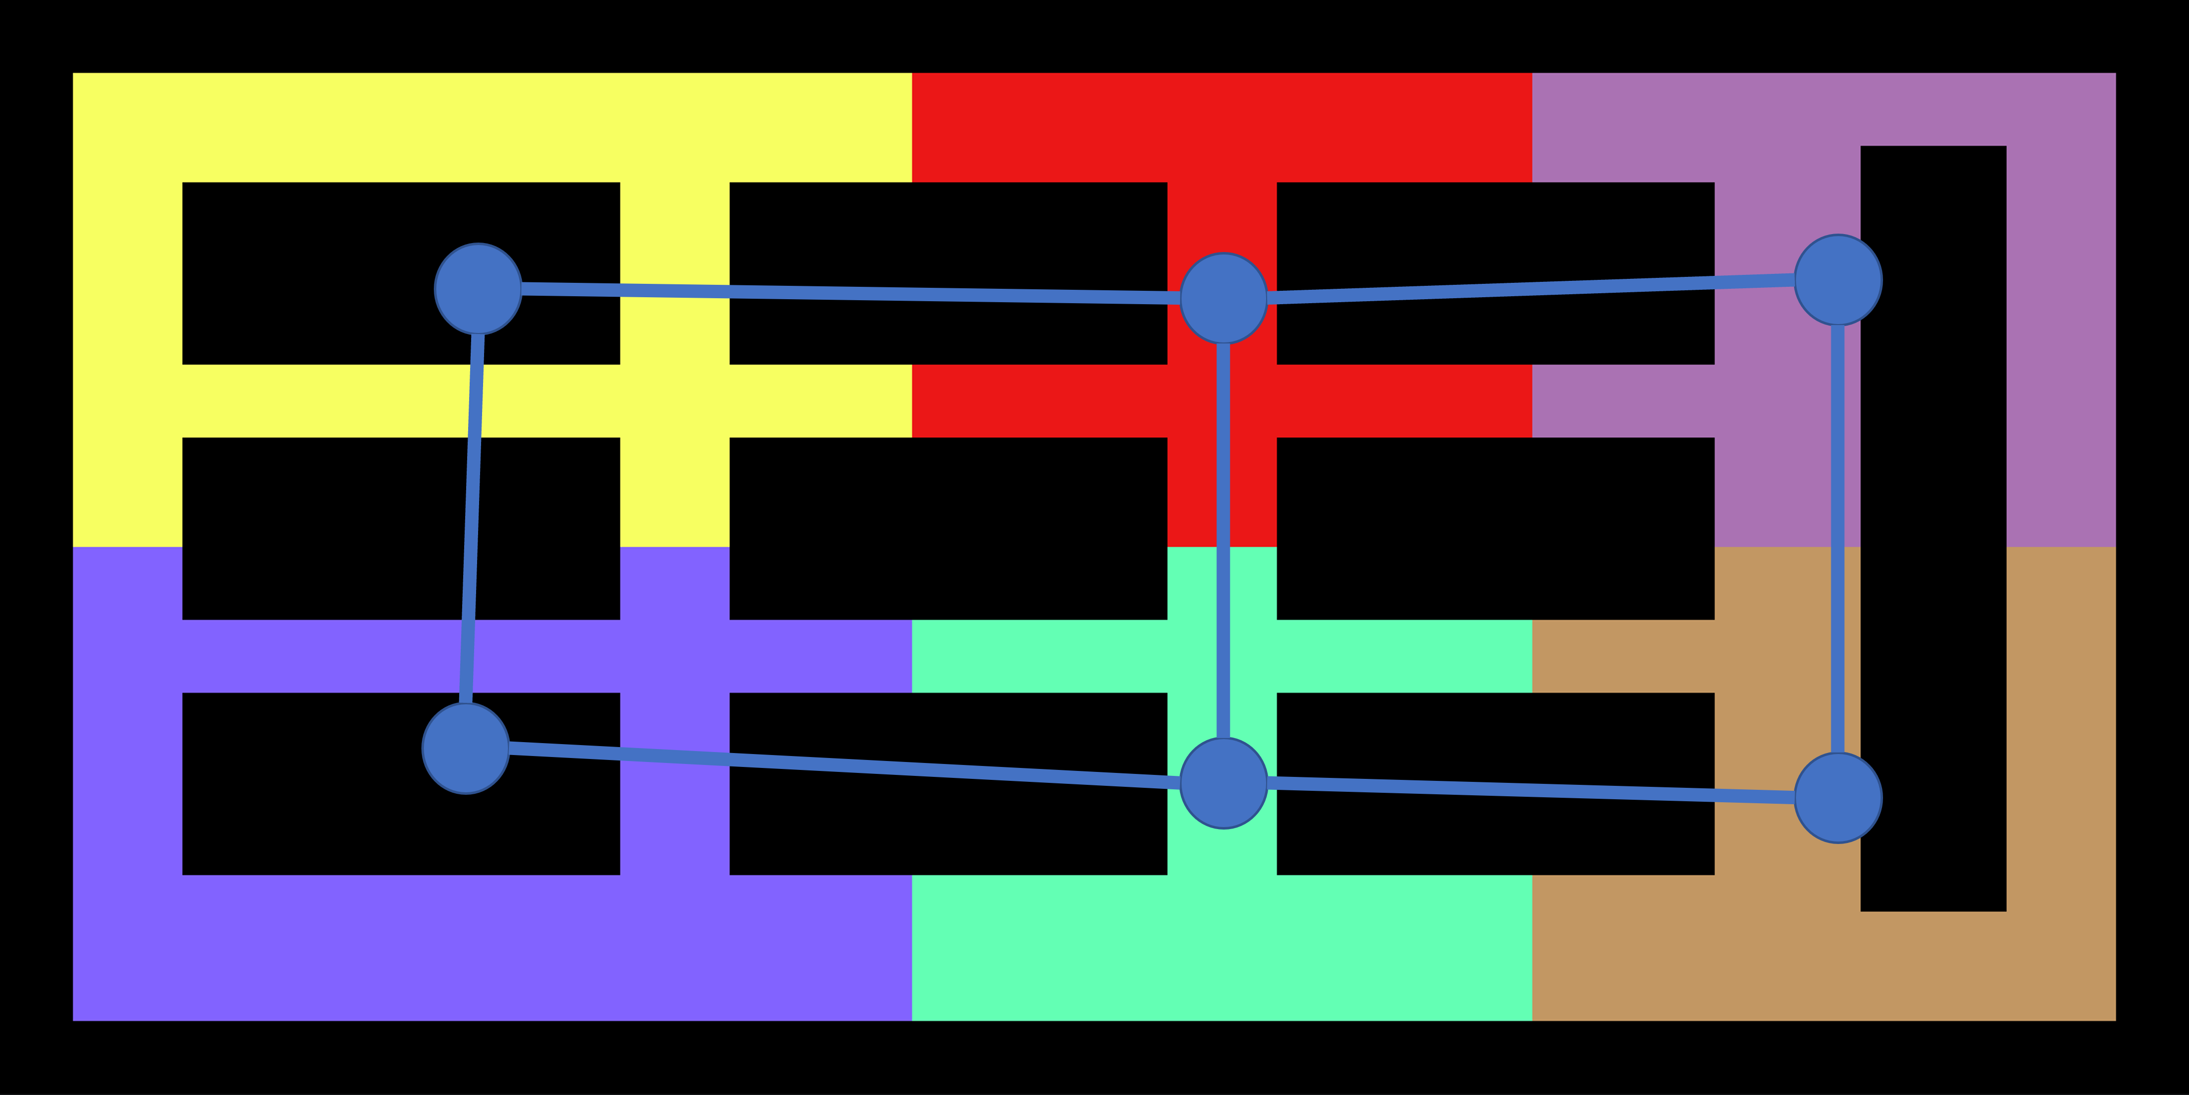
2.2 Offline Preprocessing Phase
Partition the original map into subsections according to the location of edges servers
Each subsection is assigned to one edge server
Original Map
Partitioned Map and Topological Map

Slide 11
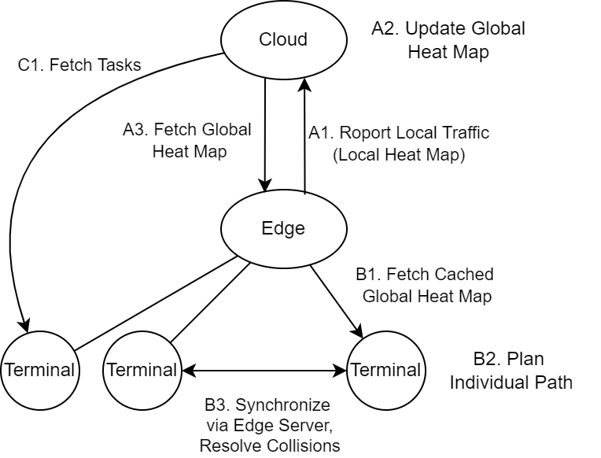
2.3 Online Scheduling Phase - Top Layer
Top Layer consists of a single node, which is a cloud server. The cloud server is lightweight and does not perform heavy computational tasks.
It maintains two types of global data:
a heat map recording the traffic of the entire system;
a task queue storing all tasks that have not been assigned to terminals (robots).

Slide 12
2.3 Online Scheduling Phase - Median Layer
Median Layer consists of edge servers. Each edge server is assigned a subsection of the map.
There are two main tasks for an edge server.
First, all terminals (robots) currently in a subsection will be assigned to the corresponding edge server. This edge server will help synchronize those terminals and detect potential collisions (Figure-B3).
Second, an edge server will gather local traffic information (heat map) and periodically report the local traffic to the cloud server (Figure-A1&A2). Then edge servers will fetch and buffer the latest global heat map (Figure-A3) so that terminals can query the global heat map from their edge servers.

Slide 13
2.3 Online Scheduling Phase - Bottom Layer
Terminals (robots) belong to the bottom layer. Each terminal will fetch the heat map from its assigned edge server (Figure-B1) and perform path planning asynchronously with the help of the heat map (Figure-B2). Terminals will be informed by edge servers if there is a potential collision.
In addition, if a terminal reaches its current goal location (i.e. the current task is accomplished), it will fetch a new task from the cloud server (Figure-C1).

Slide 14
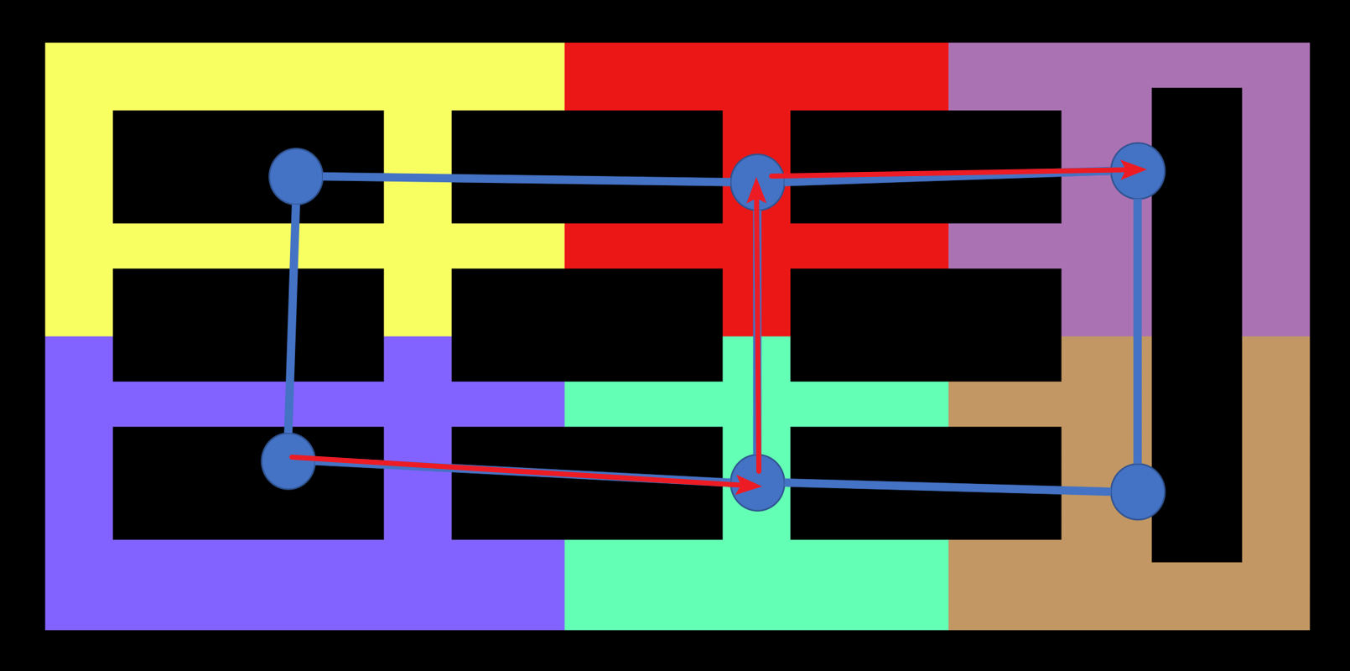
2.3 Online Scheduling Phase - Bottom Layer
Two-level Path Planning Strategy:
Plan path in the topological map to reduce search space
Plan path in the reduced grid map with the help of heat maps
Step 1: Plan path in the topological map

Slide 15
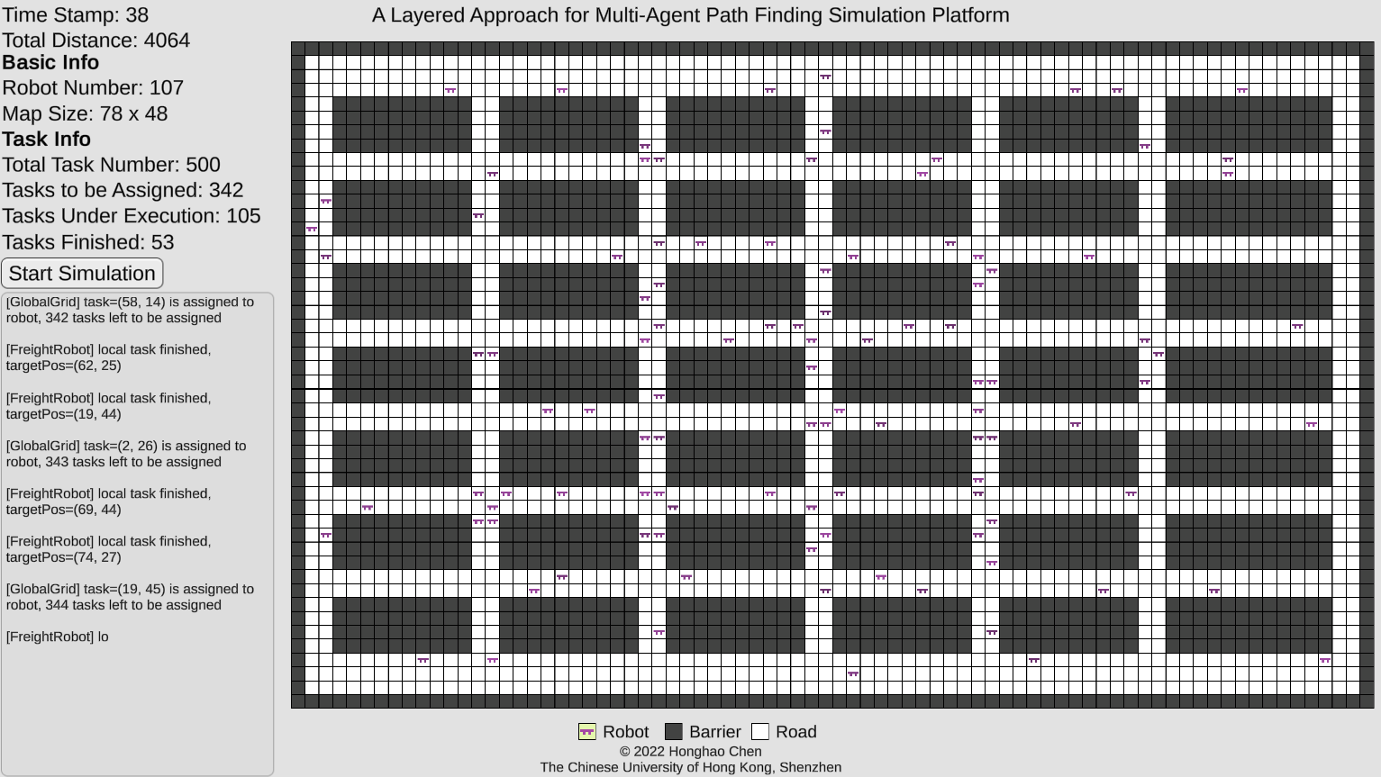
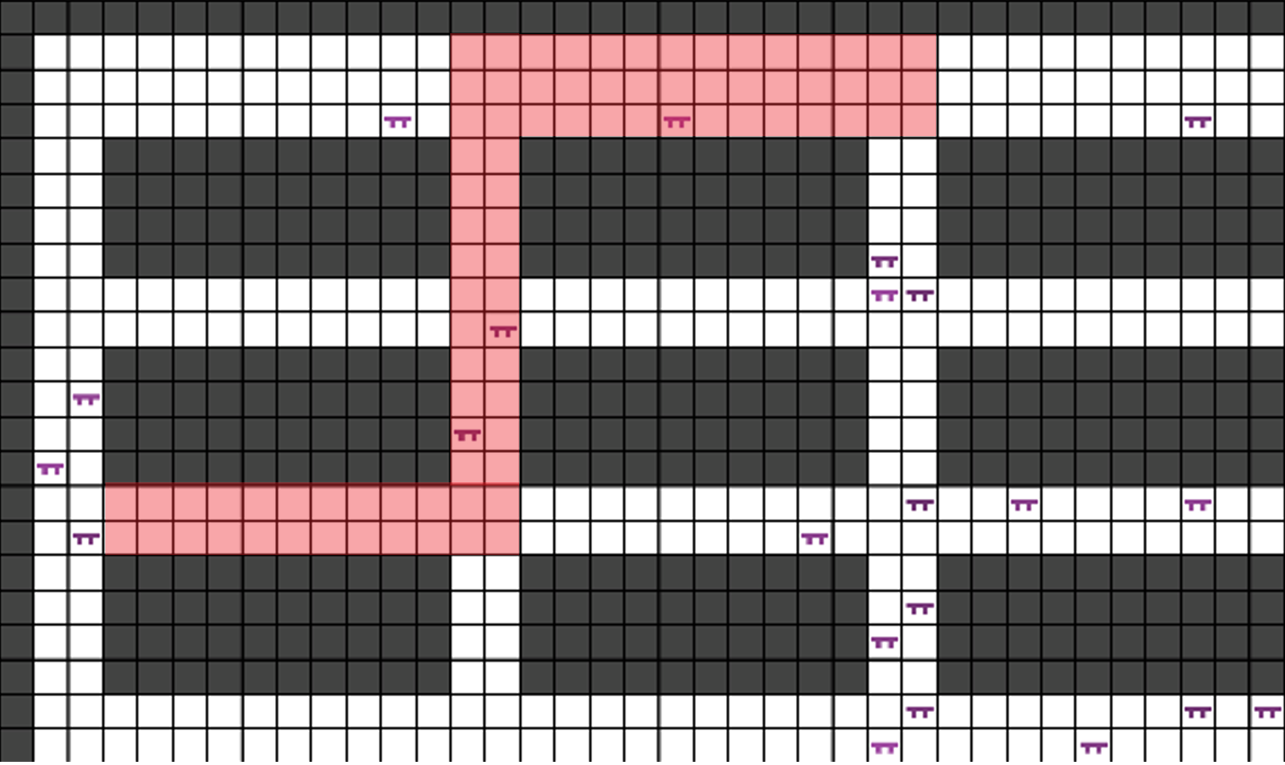
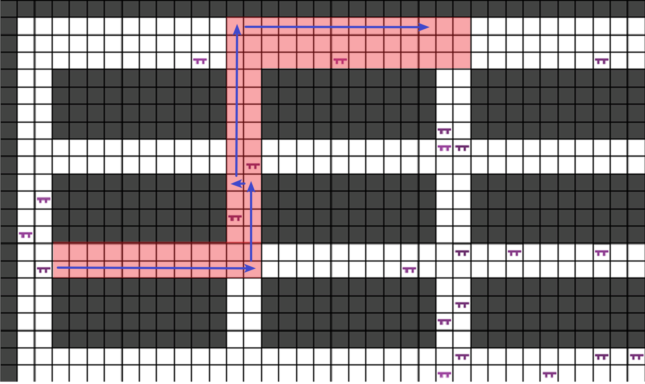
2.3 Online Scheduling Phase - Bottom Layer
Two-level Path Planning Strategy:
Plan path in the topological map to reduce search space
Plan path in the reduced grid map with the help of heat maps
Step 2-1: Original Grid Map
Step 2-2: Reduced Grid Map (Red Part)
Step 2-3: Plan Path (Blue Line)

Slide 16
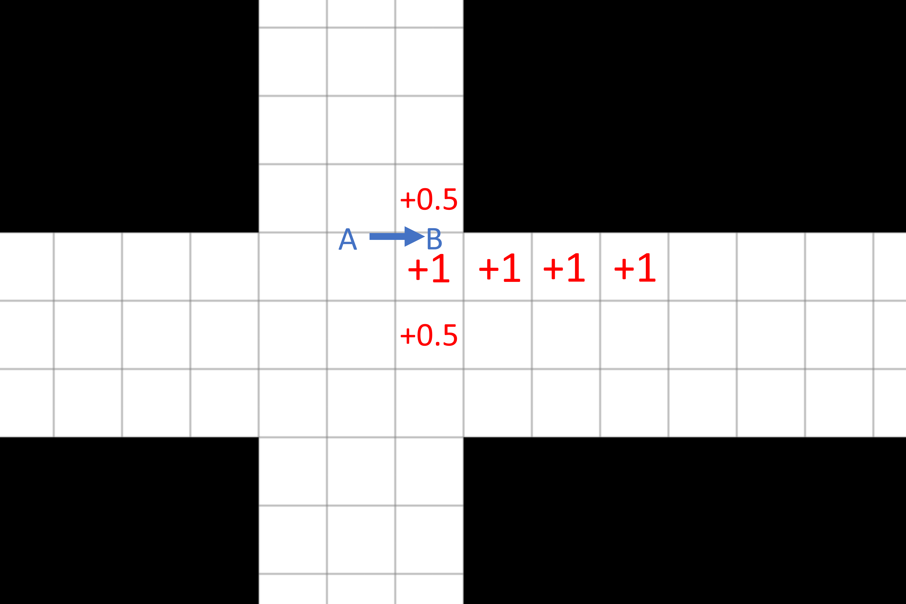
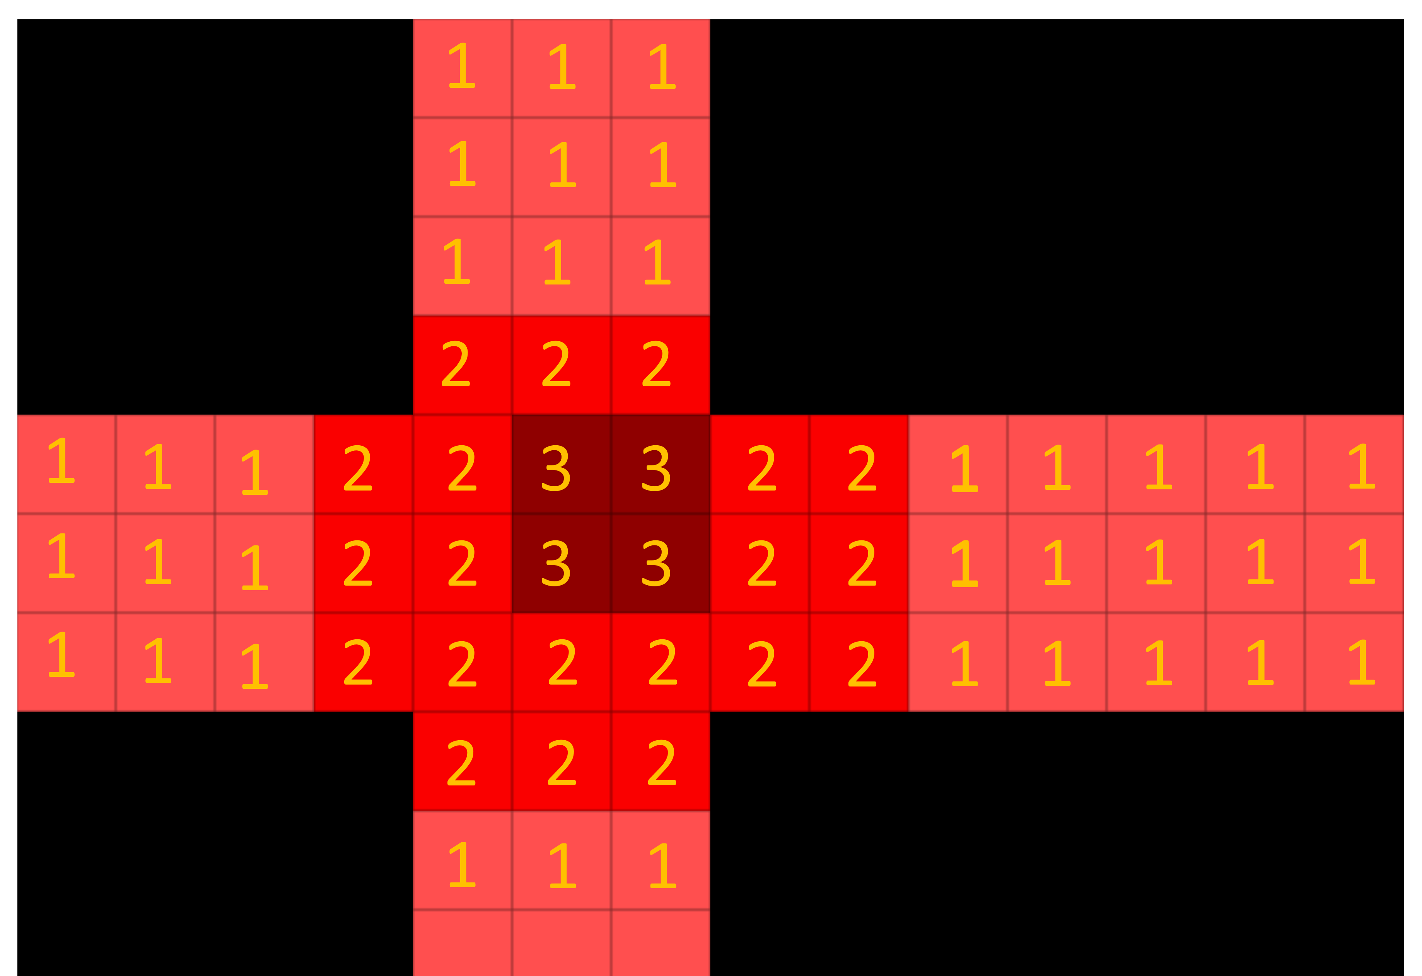
2.3 Online Scheduling Phase - Bottom Layer
Heat Map Generation:
Use A* for path finding
Entering a slot will have a default cost 1 and A* find the path with least cost
Heat Maps alter the cost of entering each slot
(1) An agent will change the cost of slots around it
(2) Combining all the cost adjustment by all agents
forms the heat map

Slide 17
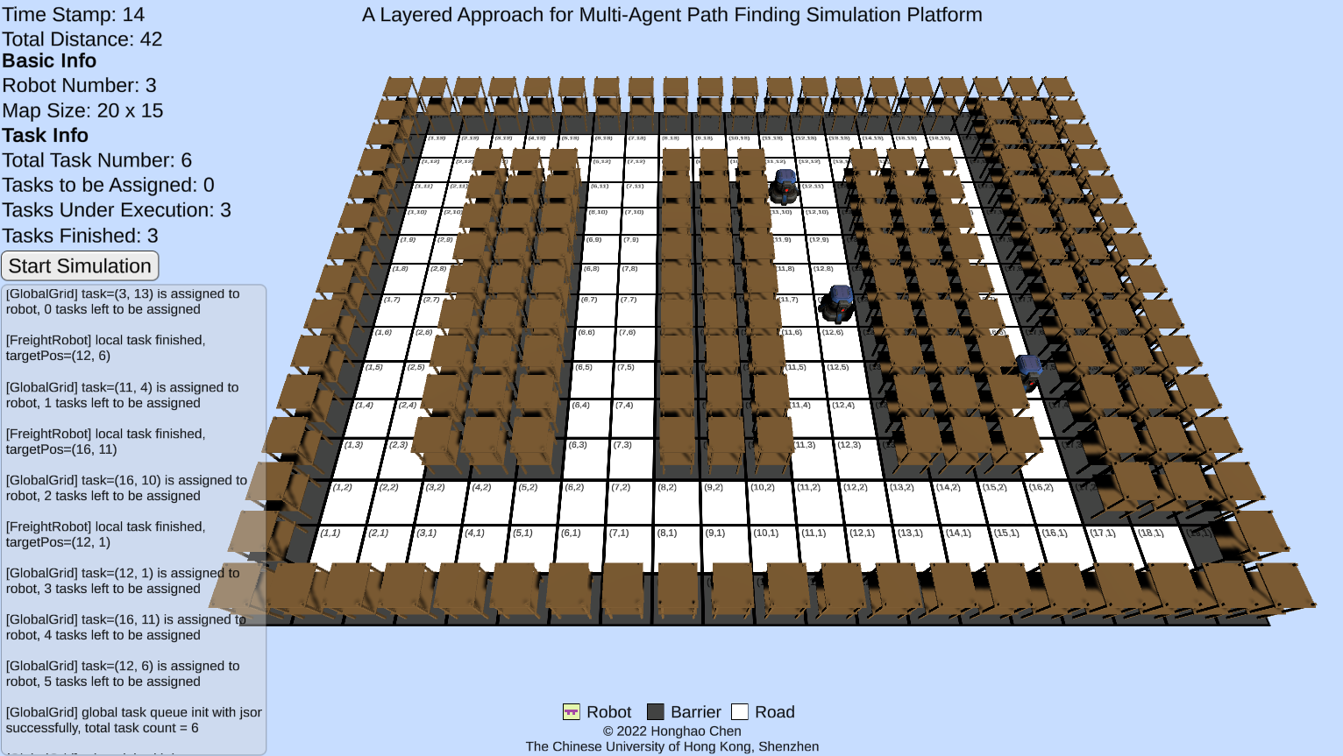
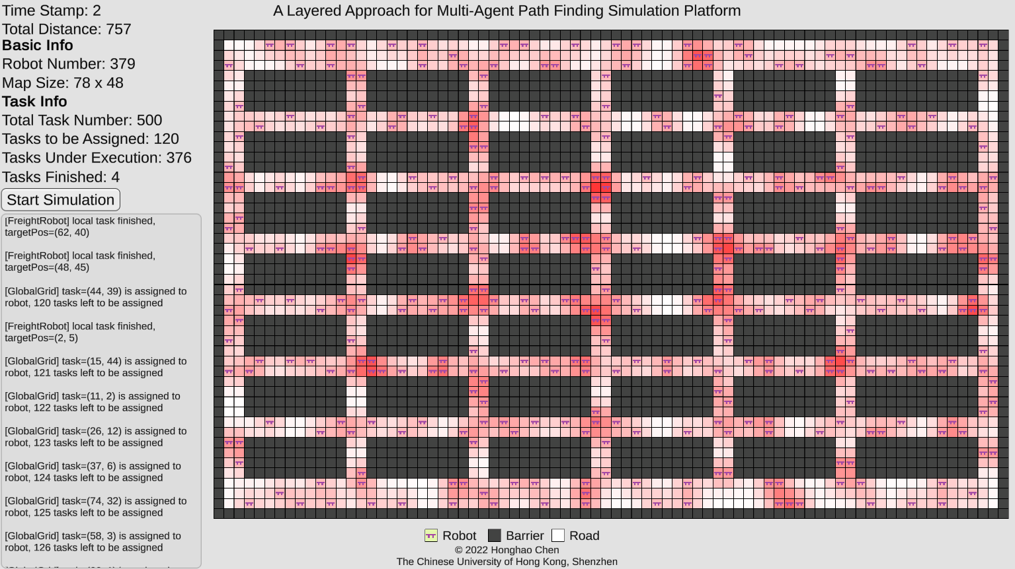
3. Simulation Results

Slide 18
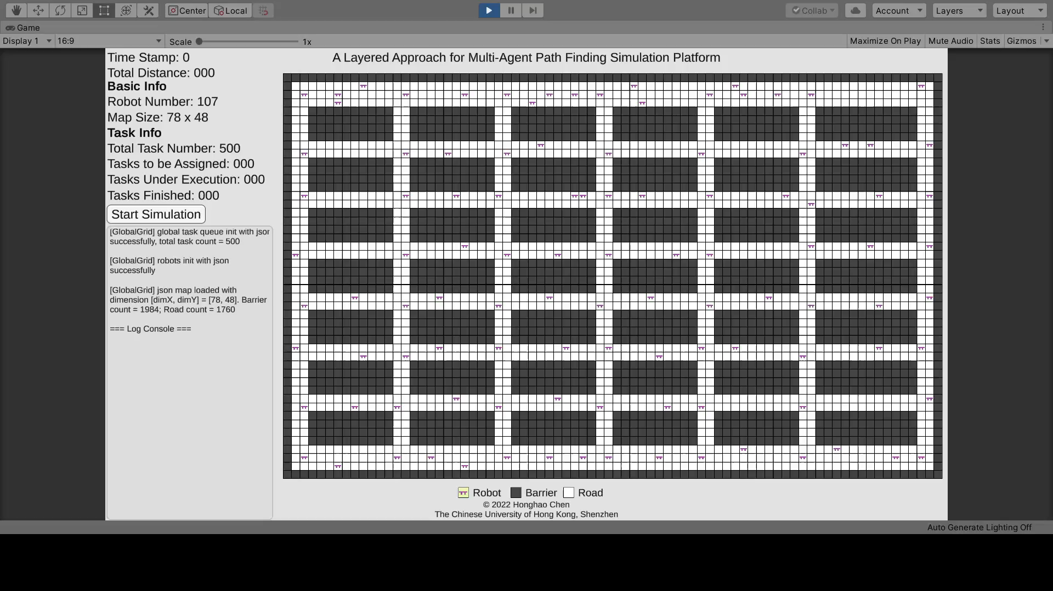
3. Simulation Results

Slide 19
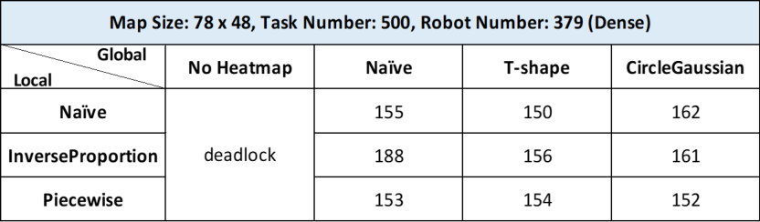
1. Simulation Results
Experiment 1: The effectiveness of heat maps
Deadlock when on heat maps are used

Slide 20
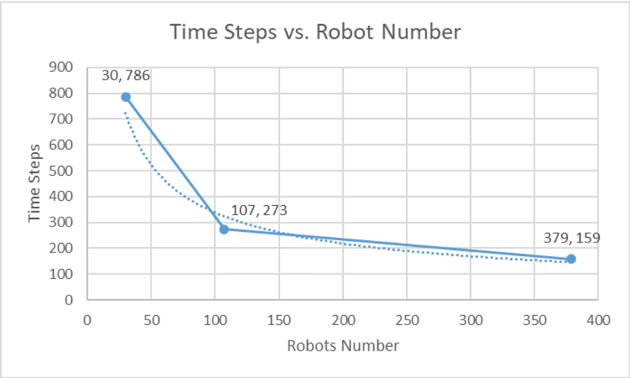
3. Simulation Results
Experiment 2: Program speedup by adding robots
More robots imply shorter time to finish all the tasks
When the robot number is large enough, adding more robots does not significantly increase performance.

Slide 21
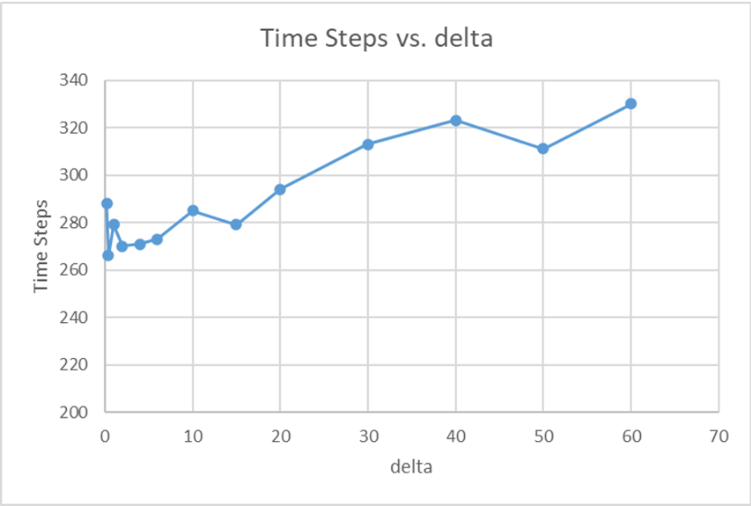
3. Simulation Results
Experiment 3: Configurable parameter values chosen in heat maps
Heat maps do not have to alter the cost of entering each slot too much.
If the parameter value is too large, the performance may decrease instead.
Influence of Configurable Parameter δ

Slide 22
Thank You!
Full demo videos of the simulation platform can be found here:
https://www.bilibili.com/video/BV1KG4y1n76b/
Source codes of the simulation platform can be found in GitHub:
https://github.com/Chen-Gary/Layered-MAPF

